Slide 1
Machine Learning
ΜΠΛΟΥΤΣΟΣ ΚΩΝΣΤΑΝΤΙΝΟΣ ΜΤΝ2017

Slide 2
Agenda
Problem state
Data
Data Pre processing
Results
Next steps

Slide 3
Problem State
Customer churn prediction
A Machine learning approach to predict how likely is a customer to leave our company based on his/her characteristics.
The focus of this exercise is on Telecommunication data, so we try to identify whether a customer is likely to abandon the specific organization.

Slide 4
Data
For the purpose of the analysis we have used data from Kaggle.
Customer level data with both numeric and categorical data as features
Binary dependent variable describing whether a specific customer has churned.
16
Categorical
3
Numeric
Gender
SeniorCitizen
Partner
Dependents
Phone Service
Multiple Lines
Internet Service
Online Security
Online Backup
Device Protection
Tech Support
Streaming TV
Streaming Movies
Contract
Paperless Billing
Payment Method
Tenure
Monthly charges
Total charges
7,043
#Customers
26%
Historical Churn rate

Slide 5
Data Pre processing
Transform categorical variables to binary with one-hot encoding
Create train/control dataset for model validation (train set is 85% randomly selected from the full dataset)
Descriptive analysis for data (both categorical and continuous data)

Slide 6
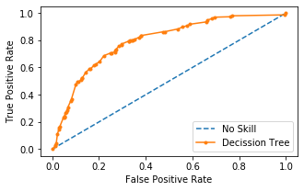
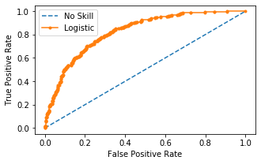
Results
Confusion Matrix for Decision Tree
Confusion Matrix for Logistic Regression
Actuals
Actuals
 | 0 | 1
0 | 679 | 87
1 | 165 | 125
Acc.: 76%
f1: 50%
 | 0 | 1
0 | 683 | 83
1 | 139 | 151
Acc.: 79%
f1: 58%
Predicted
Predicted
r: 43%
p: 52%
p: 59%
p: 65%

Slide 7
Next steps
Augment the analysis with more data
Meter data | Consumption
Invoice data | Overdues
Competition data
Collection data
Marketing / Promo data (both ATL/BTL)
Social-demographic data |loyalty data
Customer Segmentation
Assess financial impact
Personalization
Time element

